Slide 1


Slide 2
Module Overview
Changing styles programmatically
Feature detection & browser support
Summary
Course Resources & Review

Slide 3
If all else fails, script it
Changing Styles in Script

Slide 4
Changing Styles in JavaScript
var e = document.getElementById('output'); e.style.color = '#FF0000';
// using jQuery
$('output').css('color', '#FF0000');
$('output').addClass('crazyColors');
$('output').removeClass('crazyColors');
$('output').toggleClass('crazyColors');

Slide 5
What if “browser that must not be named” renders the page?
Supporting Multiple Browsers

Slide 6
Modernizr
// use in script
if (!Modernizr.cssgradients) {
// write code here if gradients not supported
}
// use in stylesheet
.no-­‐csscolumns #container {
/* what to do if columns not supported */
}
.csscolumns #container {
/* what to do if columns are supported */
}

Slide 7
CSS3 Demos Web Site
DEMO

Slide 8
Summary
Styles can be changed in script
Modernizr simplifies feature detection
Write branching logic in CSS
Write branching logic with script

Slide 9
Resources
http://www.w3.org/Style/CSS/
http://html5please.us/#css
http://www.modernizr.com
http://bit.ly/css3-msdn
http://www.css3maker.com

Slide 10
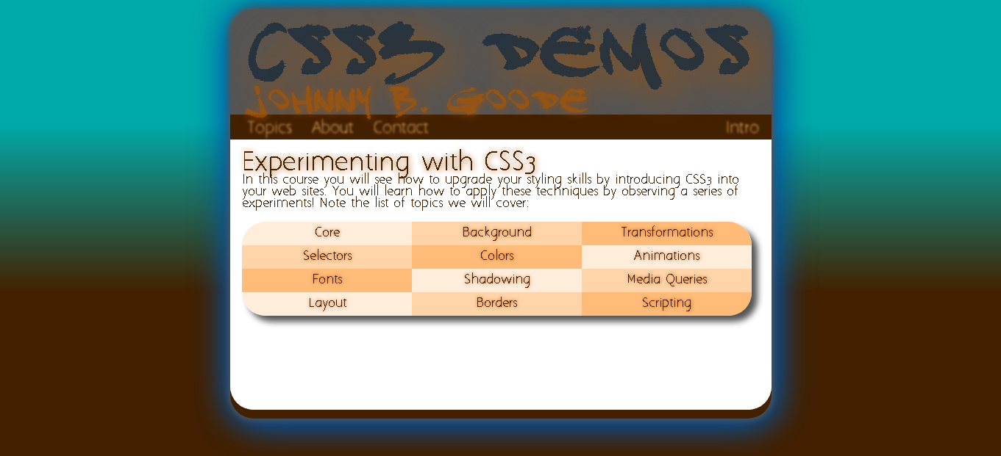
Course Review

